Slide 1
Driver 2.0

Slide 2
Team Info
Team Member:
Vasu Bhog - bhogvu@mail.uc.edu
ChaoYang Zhu - zhucy@mail.uc.edu
Chunjie Pan - pance@mail.uc.edu
Project Advisor:
Frank Zhou - zhoxu@ucmail.uc.edu

Slide 3
Problem
There have been millions of car crashes over the years due to distracted drivers and dangerous objects. Car crashes are continuously increasing and the issue is with drivers that are not aware or distracted. We need to find a solution that everyday drivers can utilize instead of buying a completely new vehicle.

Slide 4
Problem
There is no device that currently out there that detects objects, tired drivers, and road signs for drivers all together. There are currently only advanced cars that cost hundreds of thousands of dollars that have sensors and cameras built in the vehicle.
An issue arises as not everyone can afford these expensive vehicles.

Slide 5
Solution
A device that can detect and notify drivers about dangerous objects and distractions on the road in order to reduce the likelihood of a crash along with increasing safety.

Slide 6
Project Abstract
Billions of people still drive on the road and have barely any assistance from smart devices to help them while driving. There is a continuous increase in crashes over the years, and there are more and more drivers that are getting on the road. Our project will aim at creating a simple interface based device that will use computer vision and machine learning to detect dangerous situations and objects on the road. This will decrease the probability of crashes and injury, as well as increase the awareness of the driver.

Slide 7
Goals statements
Create/Utilize devices such as Raspberry PI to process driving data
Utilize camera feed data to detect objects, drivers swaying, and road signs to enhance the driver's safety
Create an interface to help drivers in all types of conditions

Slide 8
User Stories
As a driver, I want to be able to utilize the device to enable smart detection of dangerous road objects and conditions.
As a passenger, I want to be able to help navigate and aid the driver using the device and ensuring that that the driver is aware.
As a device owner, I will be able to utilize the advanced modeling that detects driver swaying and fatigue, as well as road sign detection.

Slide 9
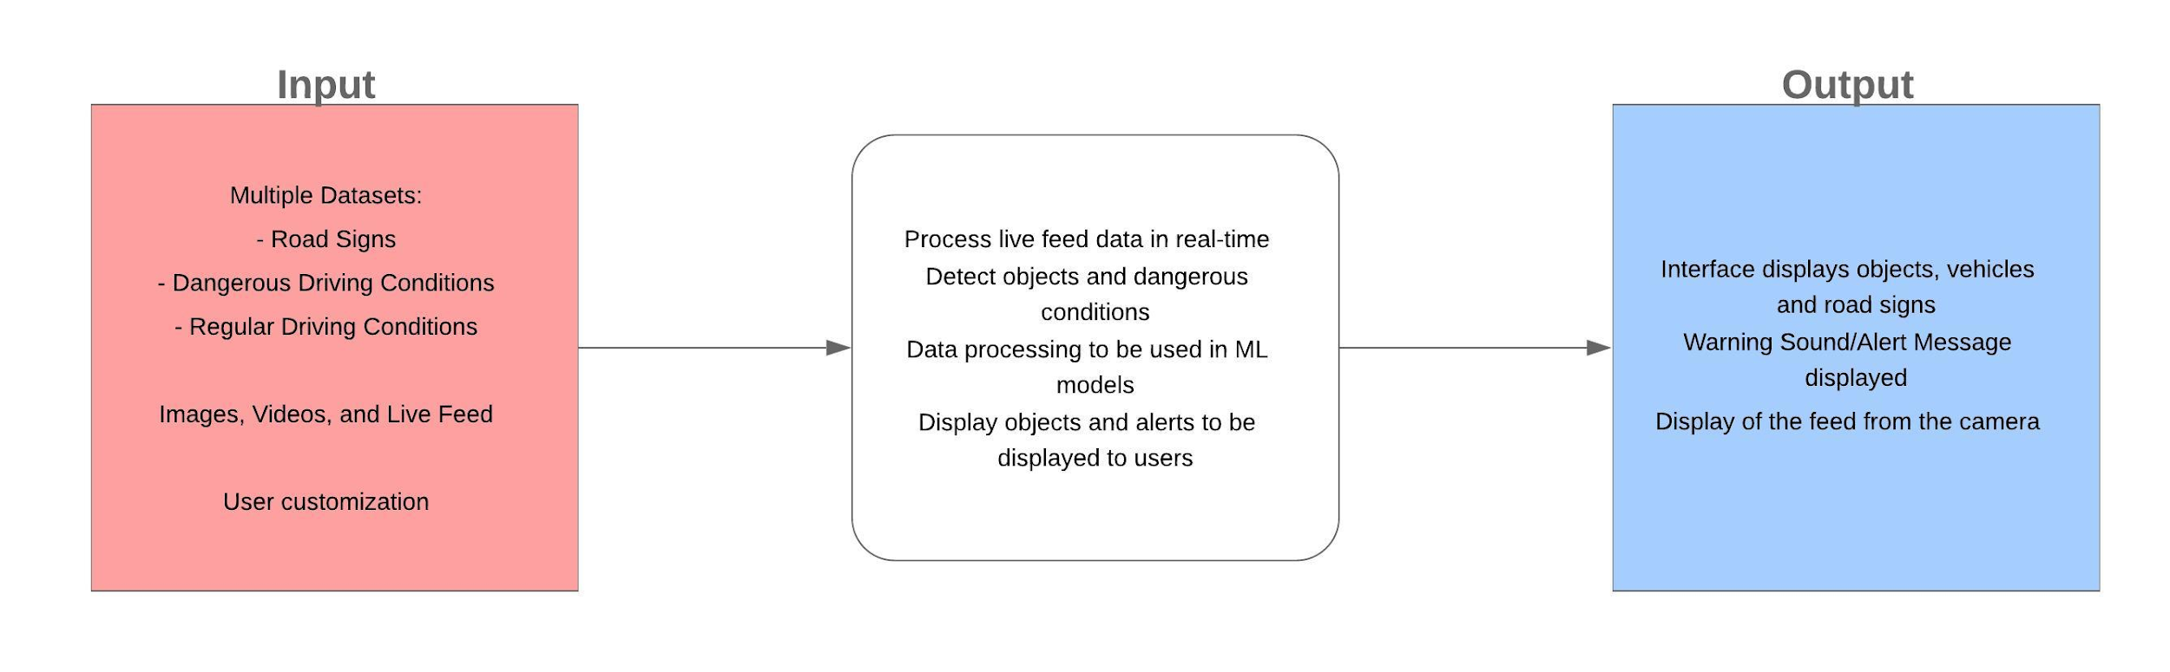
Design Diagram

Slide 10
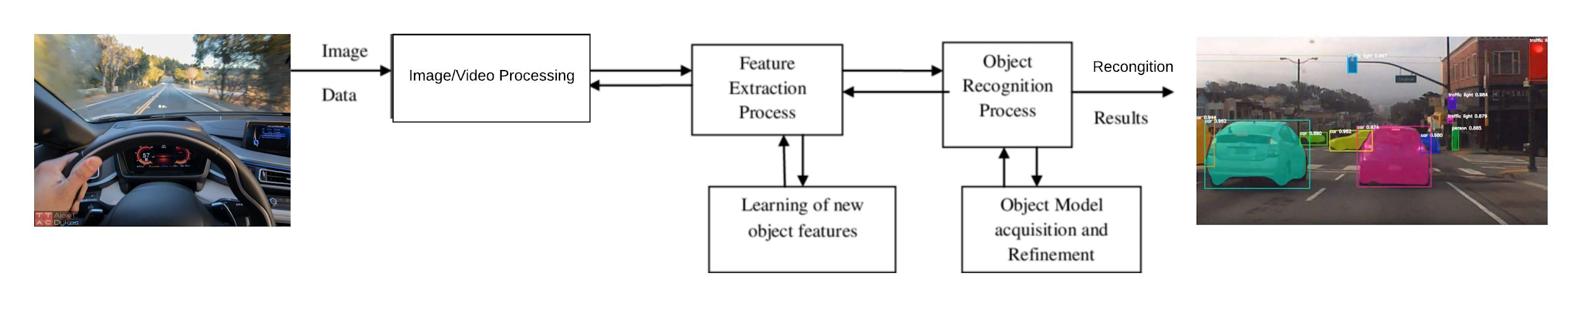
Design Diagram 2

Slide 11
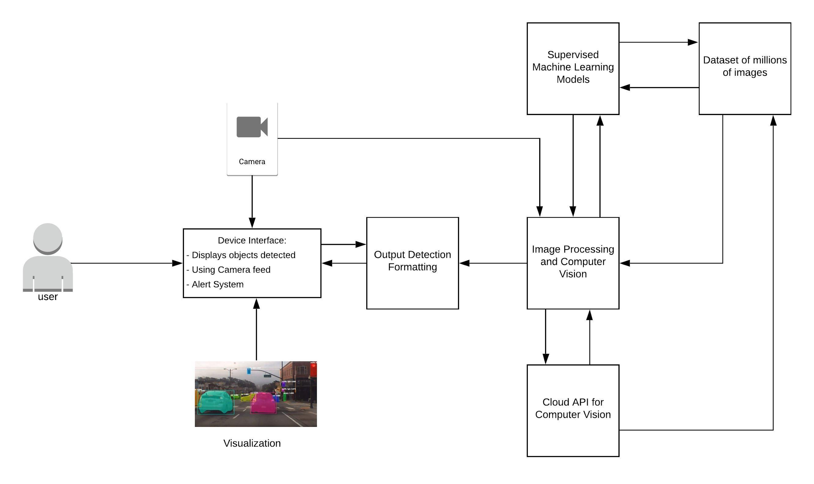
In Depth Design Diagram

Slide 12
Project Constraints
Economic Concerns
Our solution will cost us money as we need to purchase parts to create the device. In order the users end cost would be low, we will utilize inexpensive devices. We are not limited to any organization or facility as we will be using open source frameworks.
Social Concerns
Safety is of the utmost importance when it comes to driving therefore ensuring our project will be able to positively impact the safety of driving is our main focus.
Our machine will help drivers use ML and Computer Vision to attain a higher level of safety through alerting the driver of oncoming danger.

Slide 13
Current state of project
Discussed with Professor Frank about our project and got feedback from additional professors.
Researched the object detection and Raspberry Pi.
Learning OpenCV and it utilization with different programming languages.
Practicing object detection using Python and Java.

Slide 14
Expected Accomplishments for the end of this term
Understand OpenCV and practice object detection using Python/Java and Rasperberry PI.
Research how to train a machine learning model to detect road objects and dangerous conditions.
Research methods to detect multiple objects in image, video, and live feed to improve the model and device.

Slide 15
Timeline for the Project
Dates | Milestones | Tasks
Dec 02 2019 - Dec 27 2019 | Create a program that detects objects in driving video data | 1,2,3,4,5
Dec 30 2019 - Jan 10 2020 | Connect the program to the camera to read live feed data | 6,7
Jan 13 2020 - Jan 24 2020 | Setup the program to be used with Raspberry Pi | 8,9
Jan 27 2020 - Feb 14 2020 | Create an alert interface and program that triggers when objects are detected | 10,11
Feb 17 2020 - Mar 20 2020 | Implement more desired features | 12

Slide 16
Timeline and Milestone 1
MileStone 1:
Create a program that detects speed limit in a video/live feed
Task:
Understand OpenCV and practice object detection using Python or web application
Research how to train a machine learning model to detect road objects
Research methods to detect multiple objects in image, video, and live feed
Write the neural network code to be used to learn and recognize dangerous car conditions
Train the neural network with training and validation sets of dangerous objects

Slide 17
Timeline and Milestone 2
MileStone 2:
Connect the program to the camera to read live feed data
Task:
6. Set up a camera to be connected to live feed driving data
7. Write a program to detect objects as they move in the camera

Slide 18
Timeline and Milestone 3
MileStone 3:
Setup the program with Raspberry Pi
Task:
8. Connect Camera with Raspberry Pi
9. Get the full system to run on Raspberry Pi in a “live” environment

Slide 19
Timeline and Milestone 4
MileStone 4:
Create an alert interface/program that triggers when object detected
Task:
10. Write code to notify the user of the alerted object through Raspberry Pi and interface screen
11. Create an alert interface/program when an object is detected

Slide 20
Timeline and Milestone 5
MileStone 5:
Implement more desired features
Task:
12. Detect road swaying and dangerous driving through lane detection

Slide 21
Division of Work
Vasu:
OpenCV detection and setup
ML models
Utilizing setup/models for final system
Chunjie:
Rasperberry PI
Camera live feed/Interface
Connecting interface with final system
ChaoYang:
Research for multiple object detection
Enhancing neural network
Connecting results to final system

Slide 22
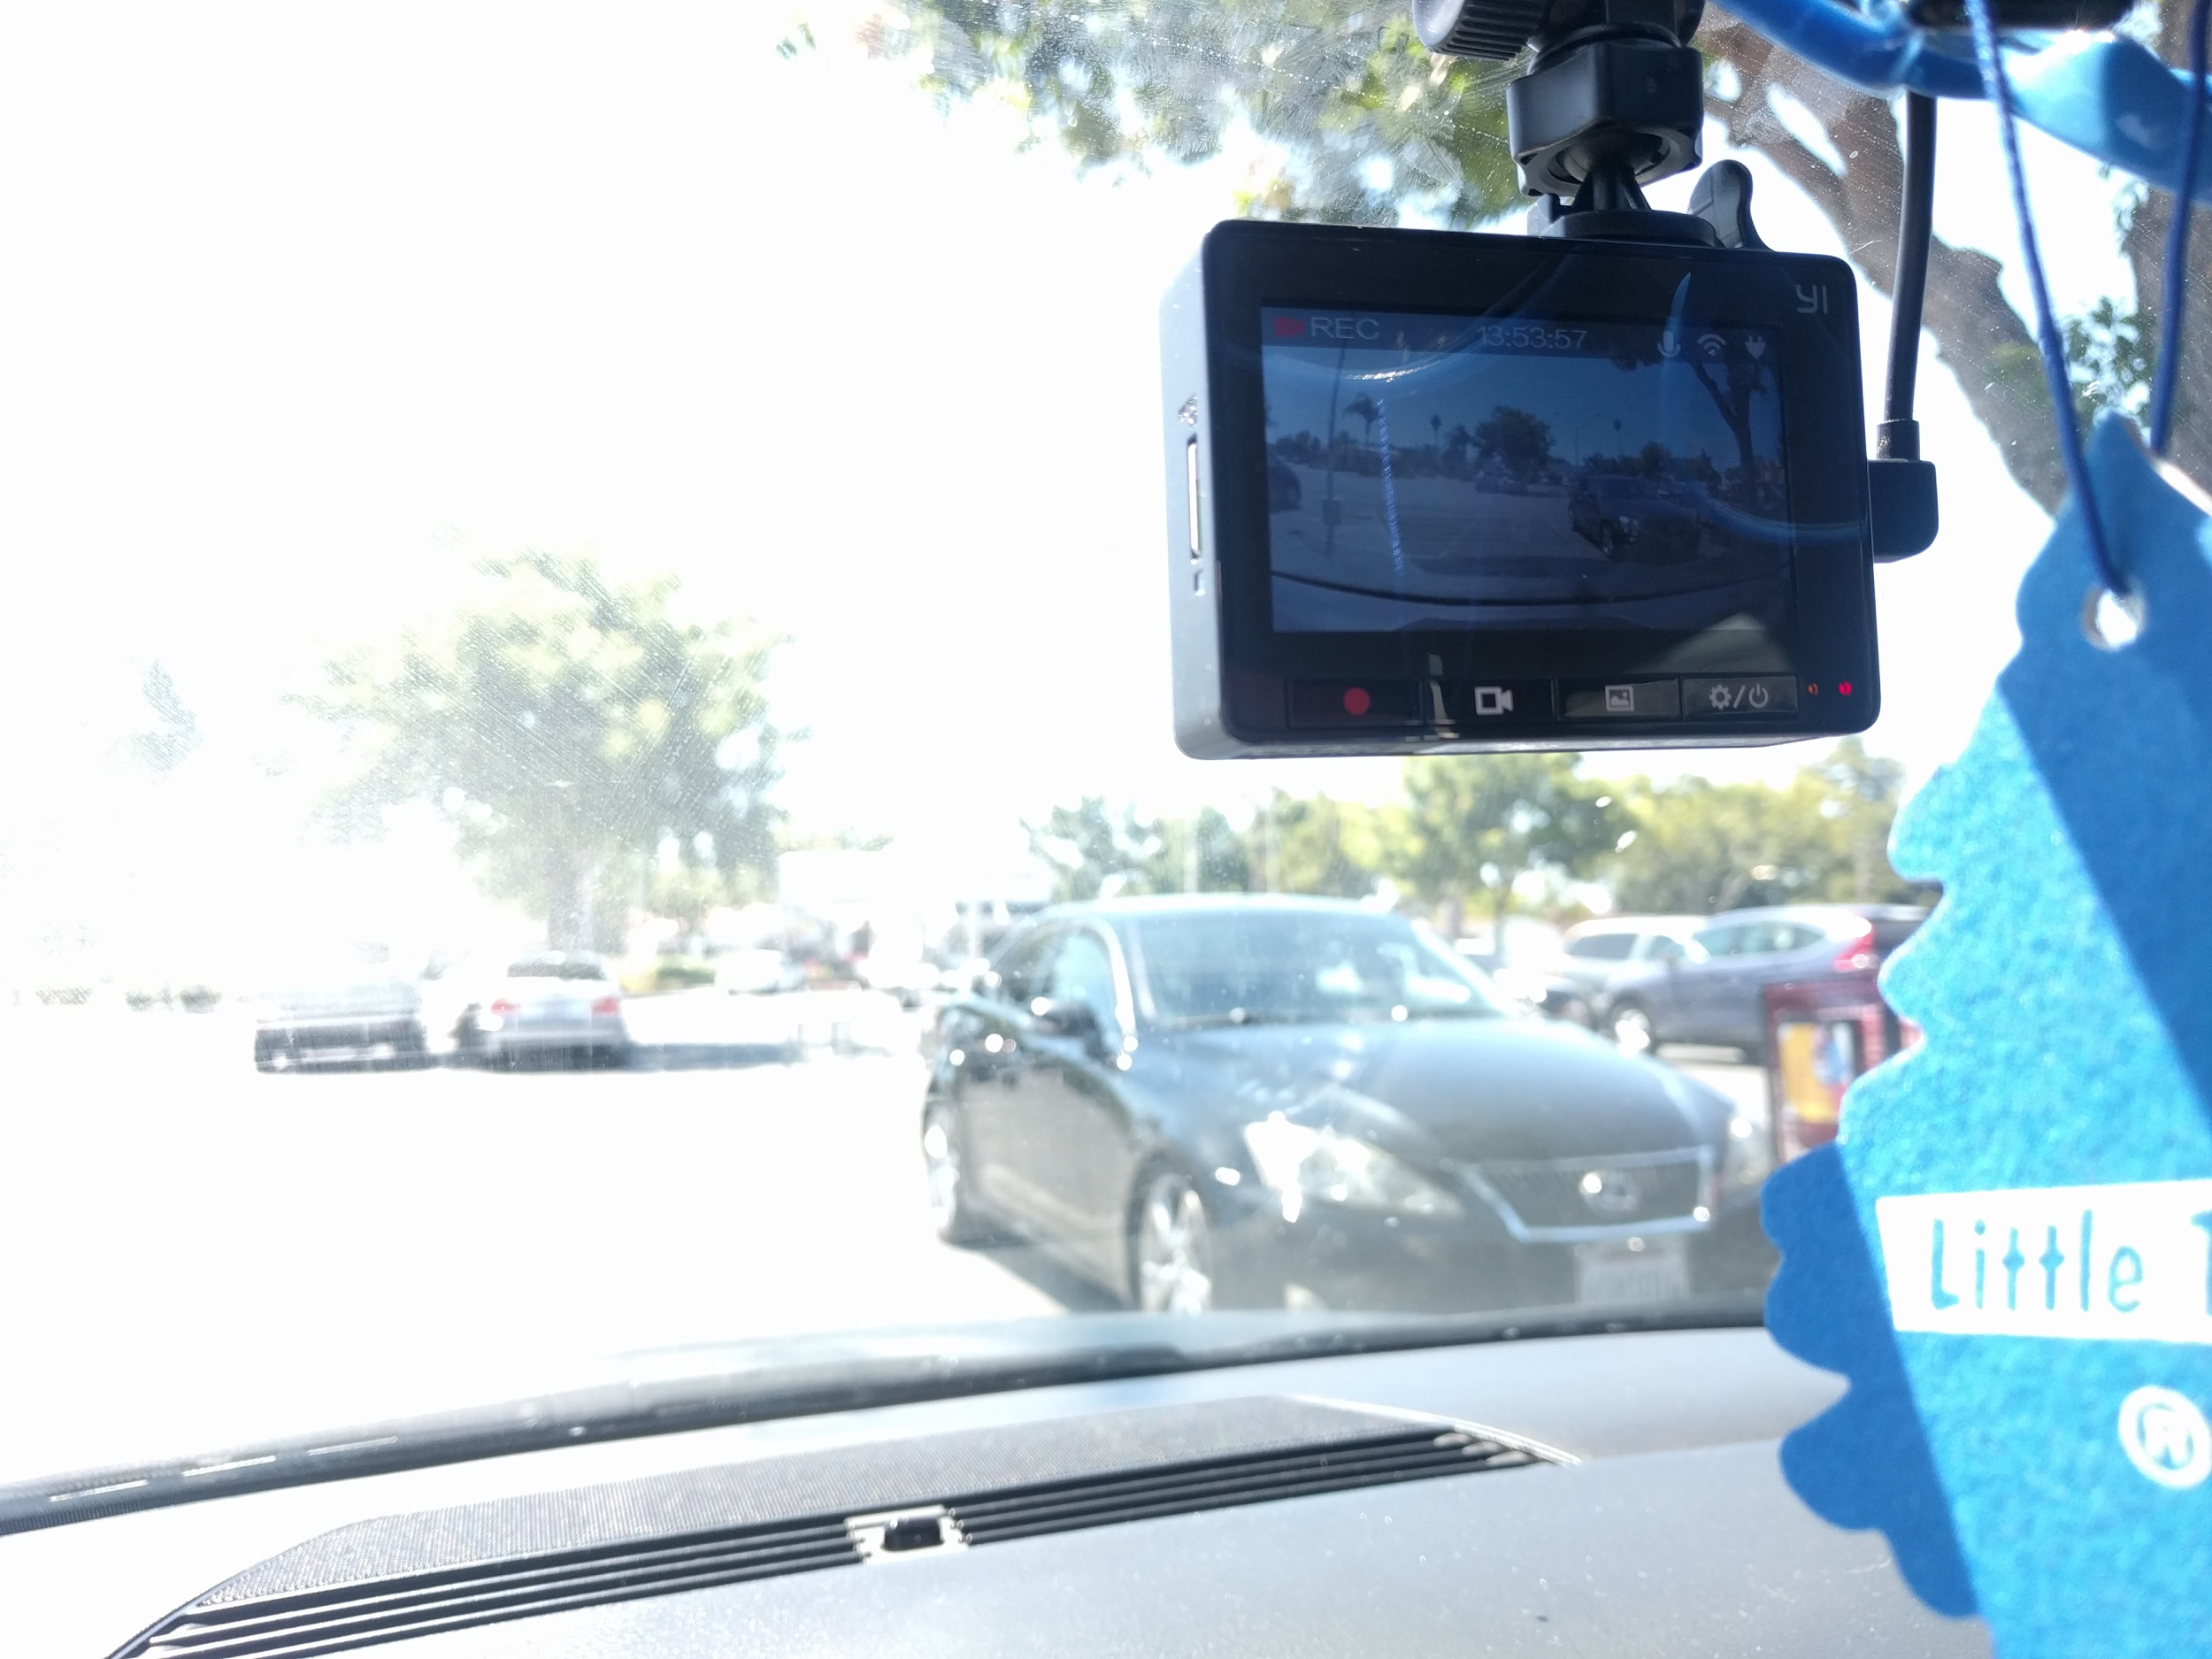
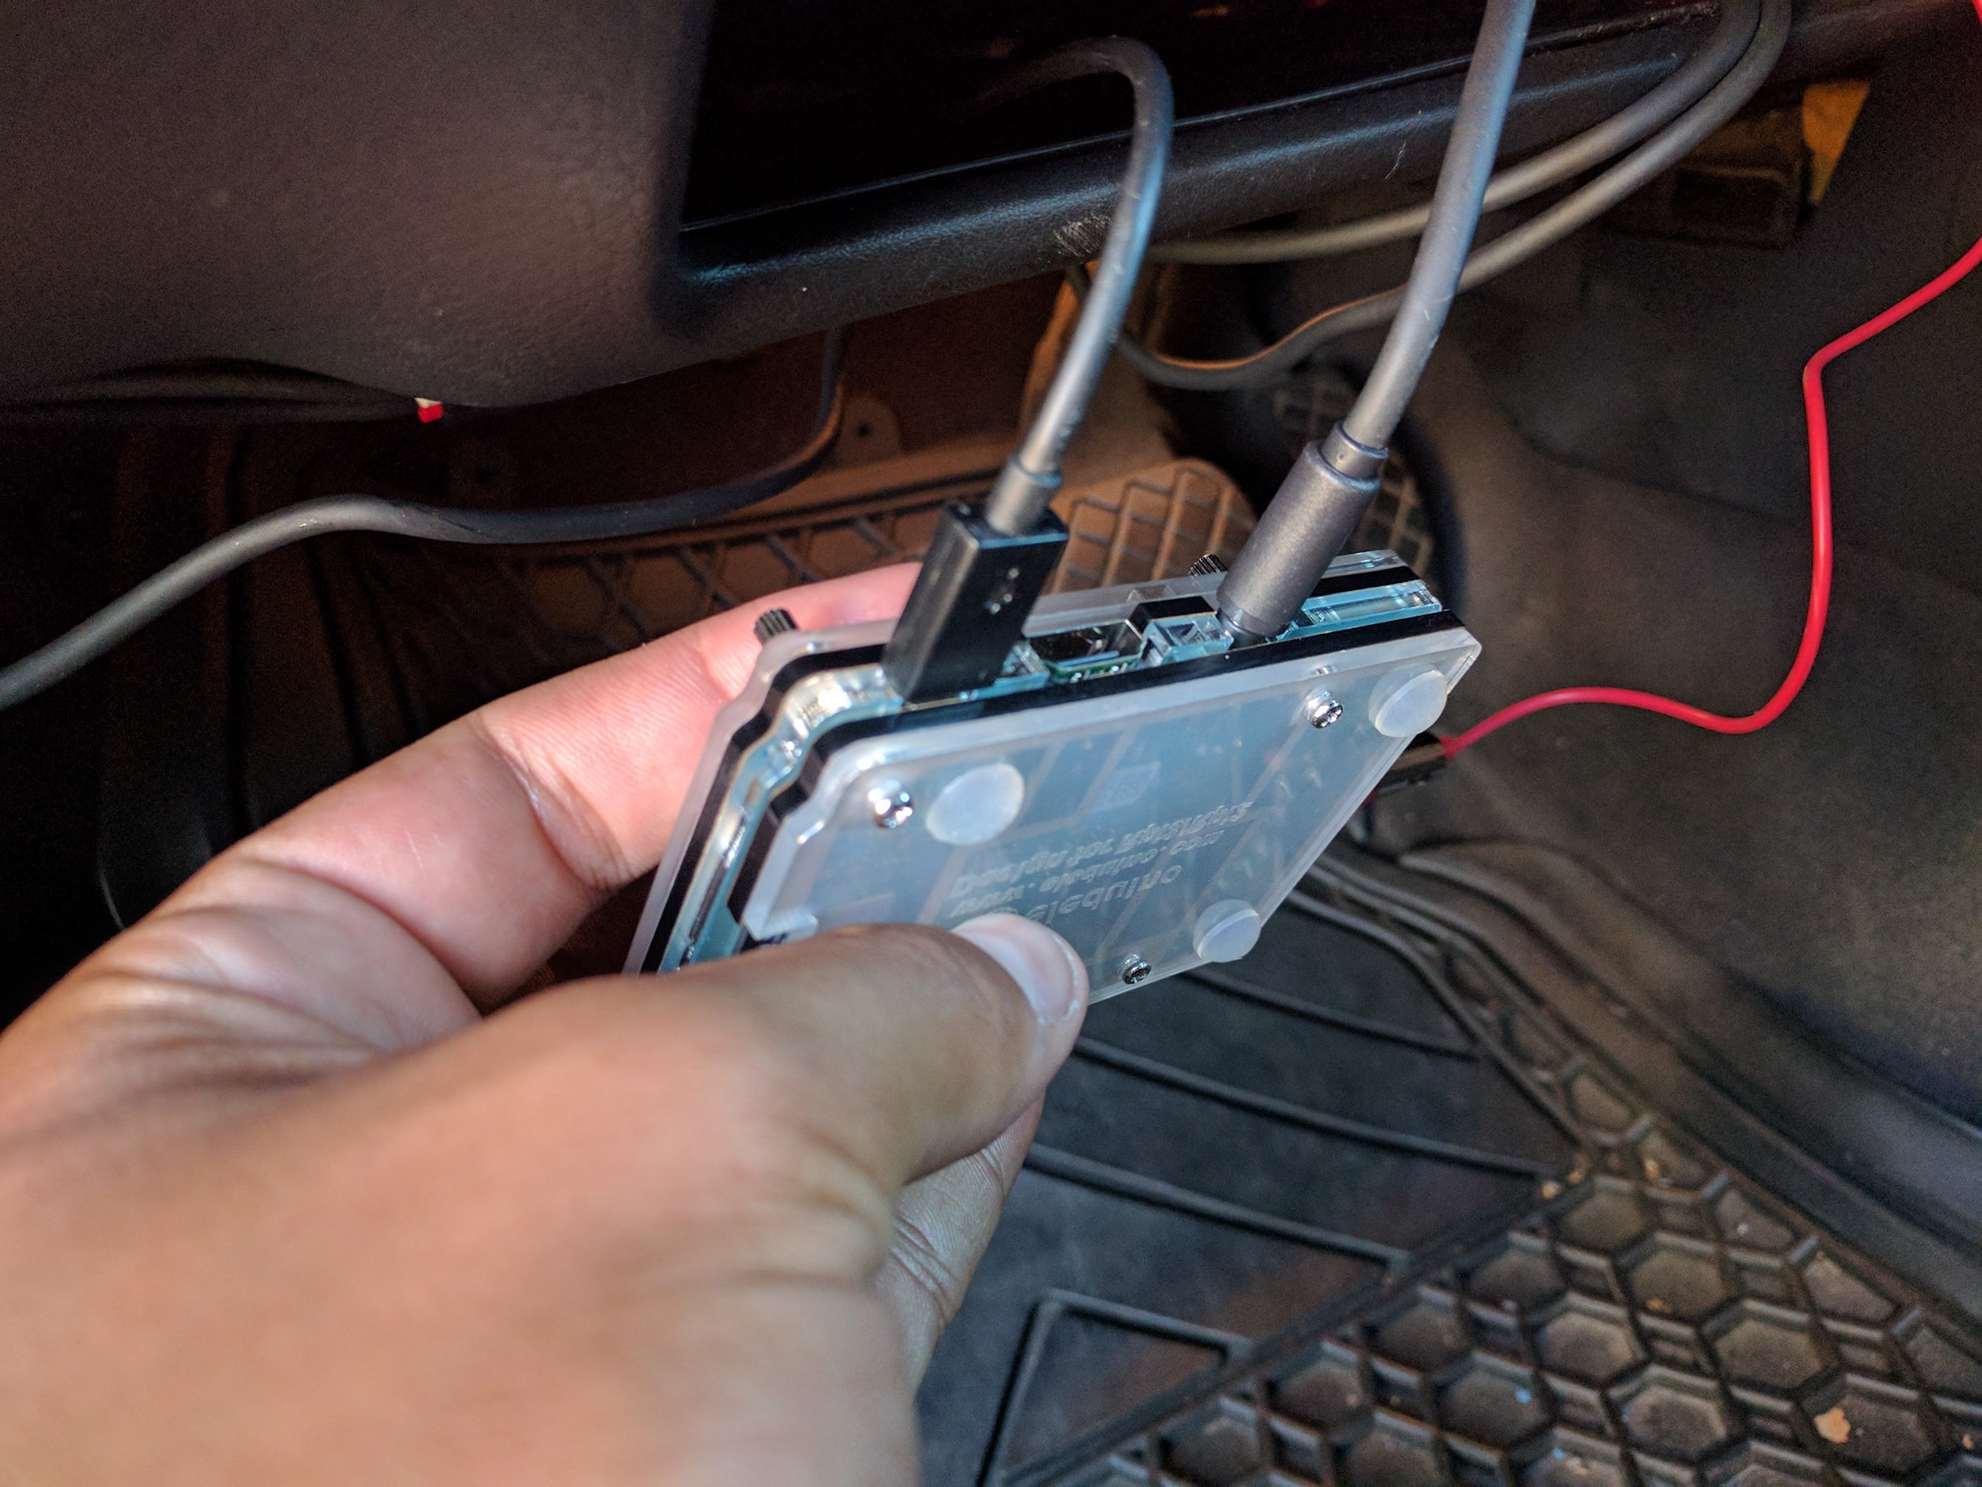
Expected Demo at Expo

Slide 23

Expected Demo at Expo

Slide 24
Credits
Follow our progress on our
Github Repo: https://github.com/VasuBhog/Senior-Project
Images used from: Google images

